Slide 1
Intelligent Whiteboard
Rahul Hebbar P R
Rohith V

Slide 2
Agenda
Recent Context
Addressing the challenge
Demonstration
Long term goals

Slide 3
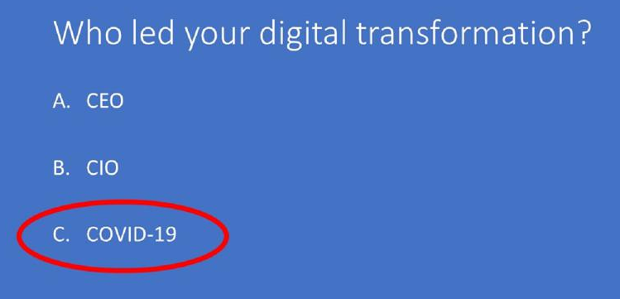
The Context
Notes:
Telecommuting

Slide 4
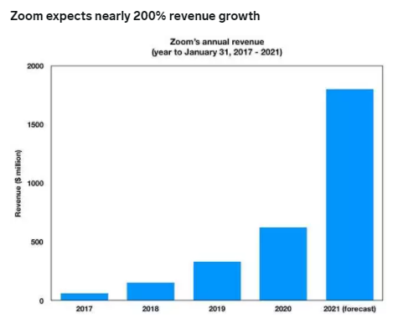
Current Market

Slide 5
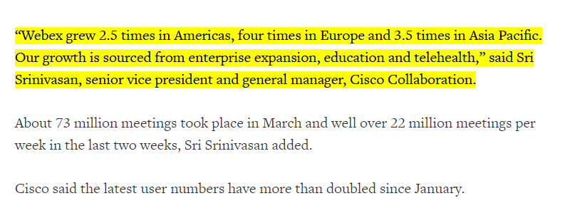

Slide 6
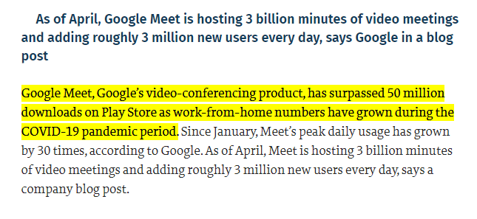

Slide 7
Industries in need of whiteboards
Schools
Businesses
Personal collaborations
Universities
Hospitals

Slide 8
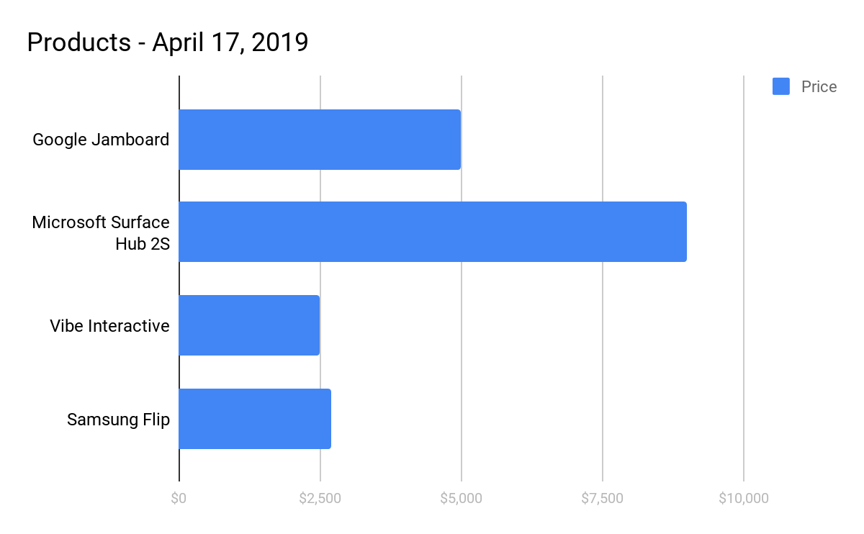
Insight on Existing Digital Whiteboards
Notes:
Whiteboards

Slide 9
Addressing the challenge
Real time collaboration
Ability to recognize handwritten texts
Download in a Digital format for future use
Deployable on any cloud based system

Slide 10
Demonstration!!

Slide 11
Key Features
Optical Character Recognition ( Pen to Text )
Brush
Text Writer
Images and Shapes
Save content

Slide 12
Technologies, Packages and Licenses
HTML, CSS, Bootstrap
Express.js - MIT
Konva.js - MIT
Socket.io - MIT
tesseract-js - permissive MIT License

Slide 13
Further Development
Include Chat, Audio and Video support
Multiple Rooms
Shape Recognition
Optical Character Recognition with images for Multiple languages

Slide 14
Source References
https://www.businessinsider.in/stock-market/news/zoom-expects-to-boost-revenue-by-200-and-profits-by-300-this-year-these-5-charts-show-the-video-conferencing-upstartaposs-explosive-growth-/slidelist/76180048.cms#slideid=76180143
https://www.forbes.com/sites/blakemorgan/2020/04/05/is-covid-19-forcing-your-digital-transformation-12-steps-to-move-faster/#4e0a2b9617bc
https://www.reuters.com/article/us-cisco-systems-webex/ciscos-webex-draws-record-324-million-users-in-march-idUSKBN21L2SY#:~:text=%E2%80%9CWebex%20grew%202.5%20times%20in,and%20general%20manager%2C%20Cisco%20Collaboration.
https://www.businessnewsdaily.com/10508-digital-whiteboards-feature.html
https://www.thehindu.com/sci-tech/technology/internet/google-meet-sees-30-fold-growth-since-january/article31631115.ece#:~:text=Google%20Meet%2C%20Google's%20video%2Dconferencing,the%20COVID%2D19%20pandemic%20period.&text=The%20time%20limit%20will%20be,30%2C%202020%2C%20says%20Google.
.

Slide 15
Library References
https://www.npmjs.com/package/konva
https://www.npmjs.com/package/express
https://www.npmjs.com/package/socket.io
https://www.npmjs.com/package/tesseract-js

Slide 16
Thank You!!
Rahul Hebbar P R - rhin1998@gmail.com
Rohith Venkatesh - rohithv355@gmail.com

